Slide 1
Iteration 2 Software Proposal Team3: Bug Killer
Xiankun Niu
Zhuoru Song
Jialin Li
Tony Xiang

Slide 2
Iteration 2 Overview — Online Restaurant Ordering System
01
Refined the Customer Module
02
Add the new Server page
03
Created the final version of Database
04
Software Testing
05
What’s next for our Iteration 3

Slide 3
01 Refined the Customer Module
Fix the bugs encountered in Iteration 1
Completed the unfinished cart page

Slide 4
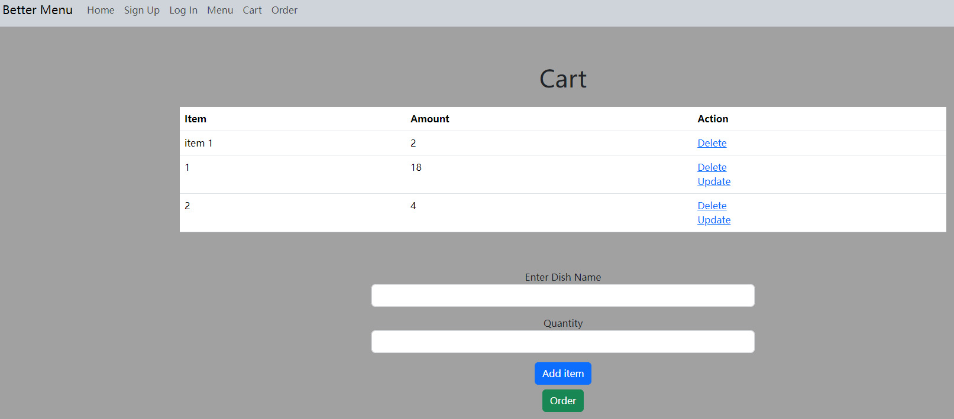

Slide 5
02 Add the new Server Page

Slide 6
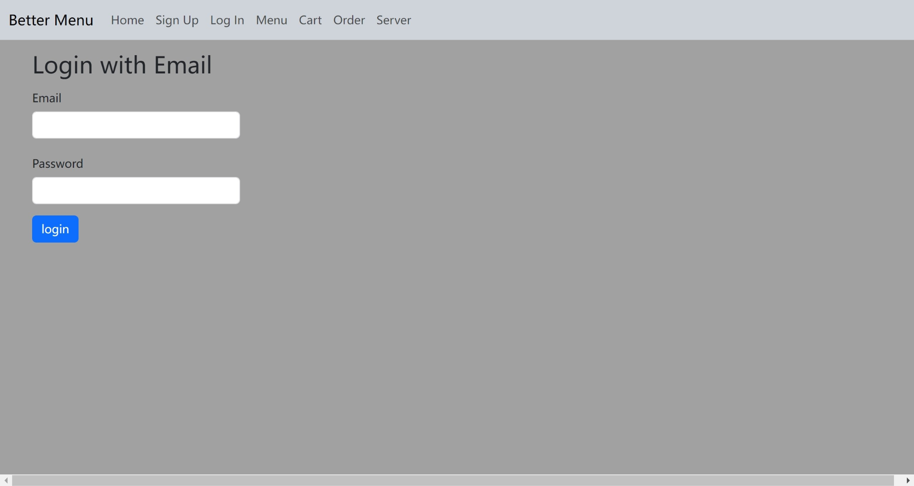

Slide 7


Slide 8
03 Created the final version of Database

Slide 9
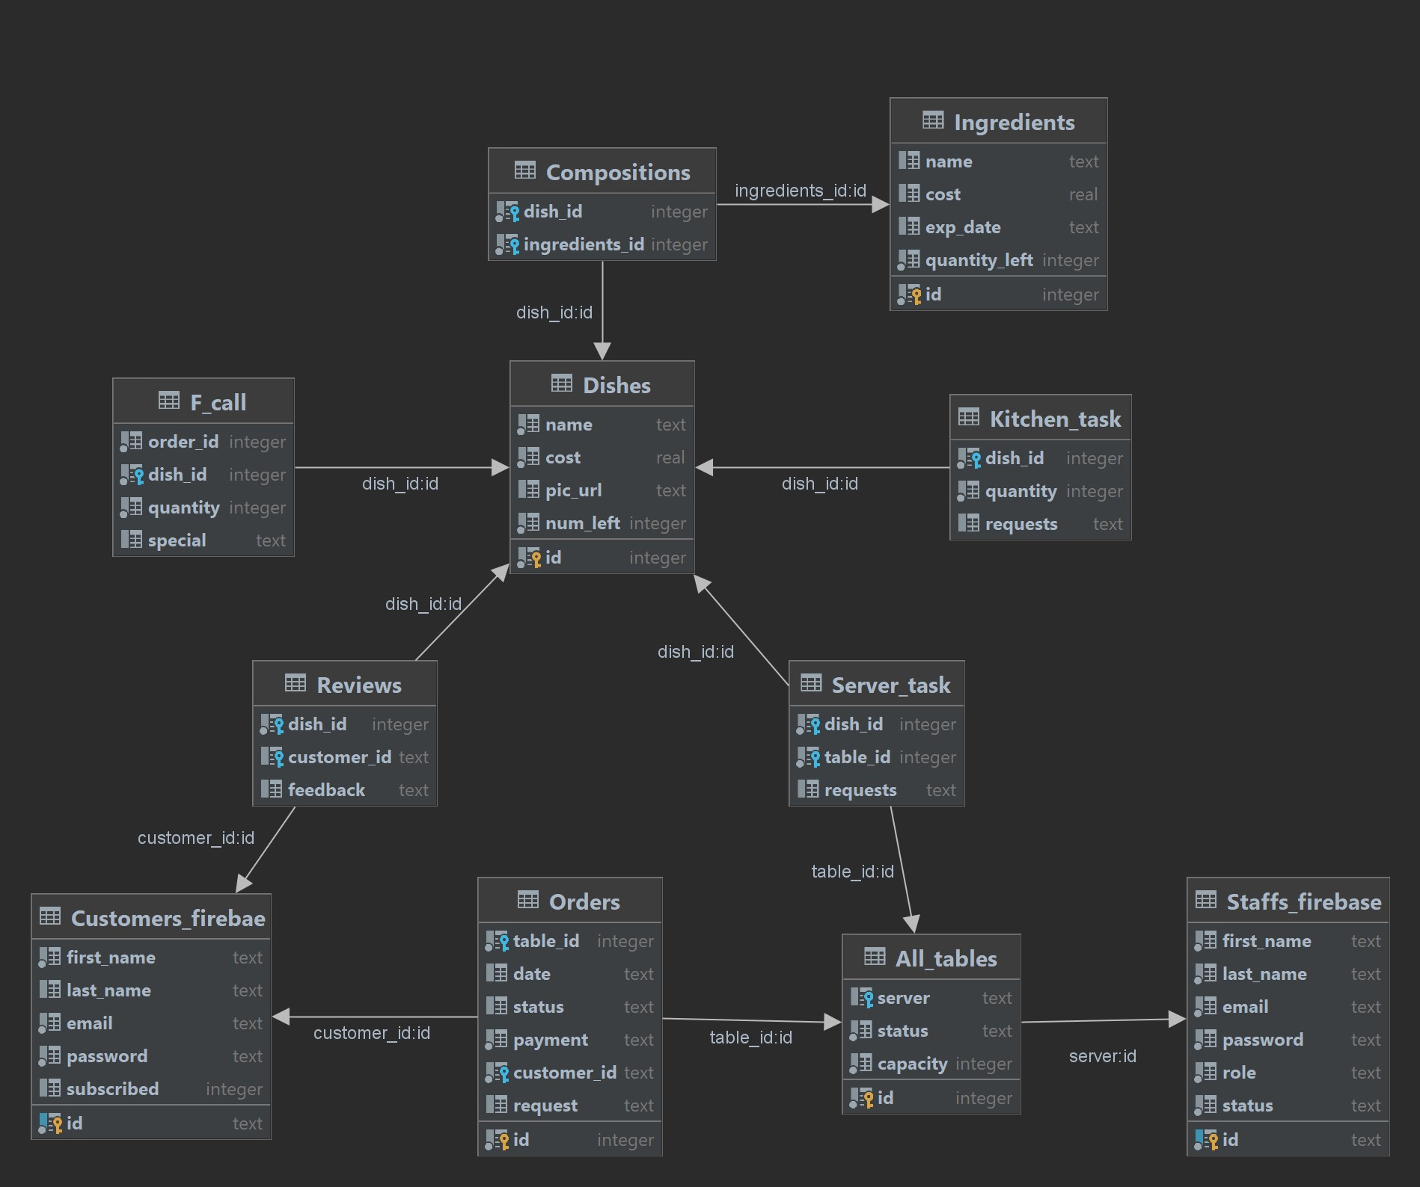

Slide 10
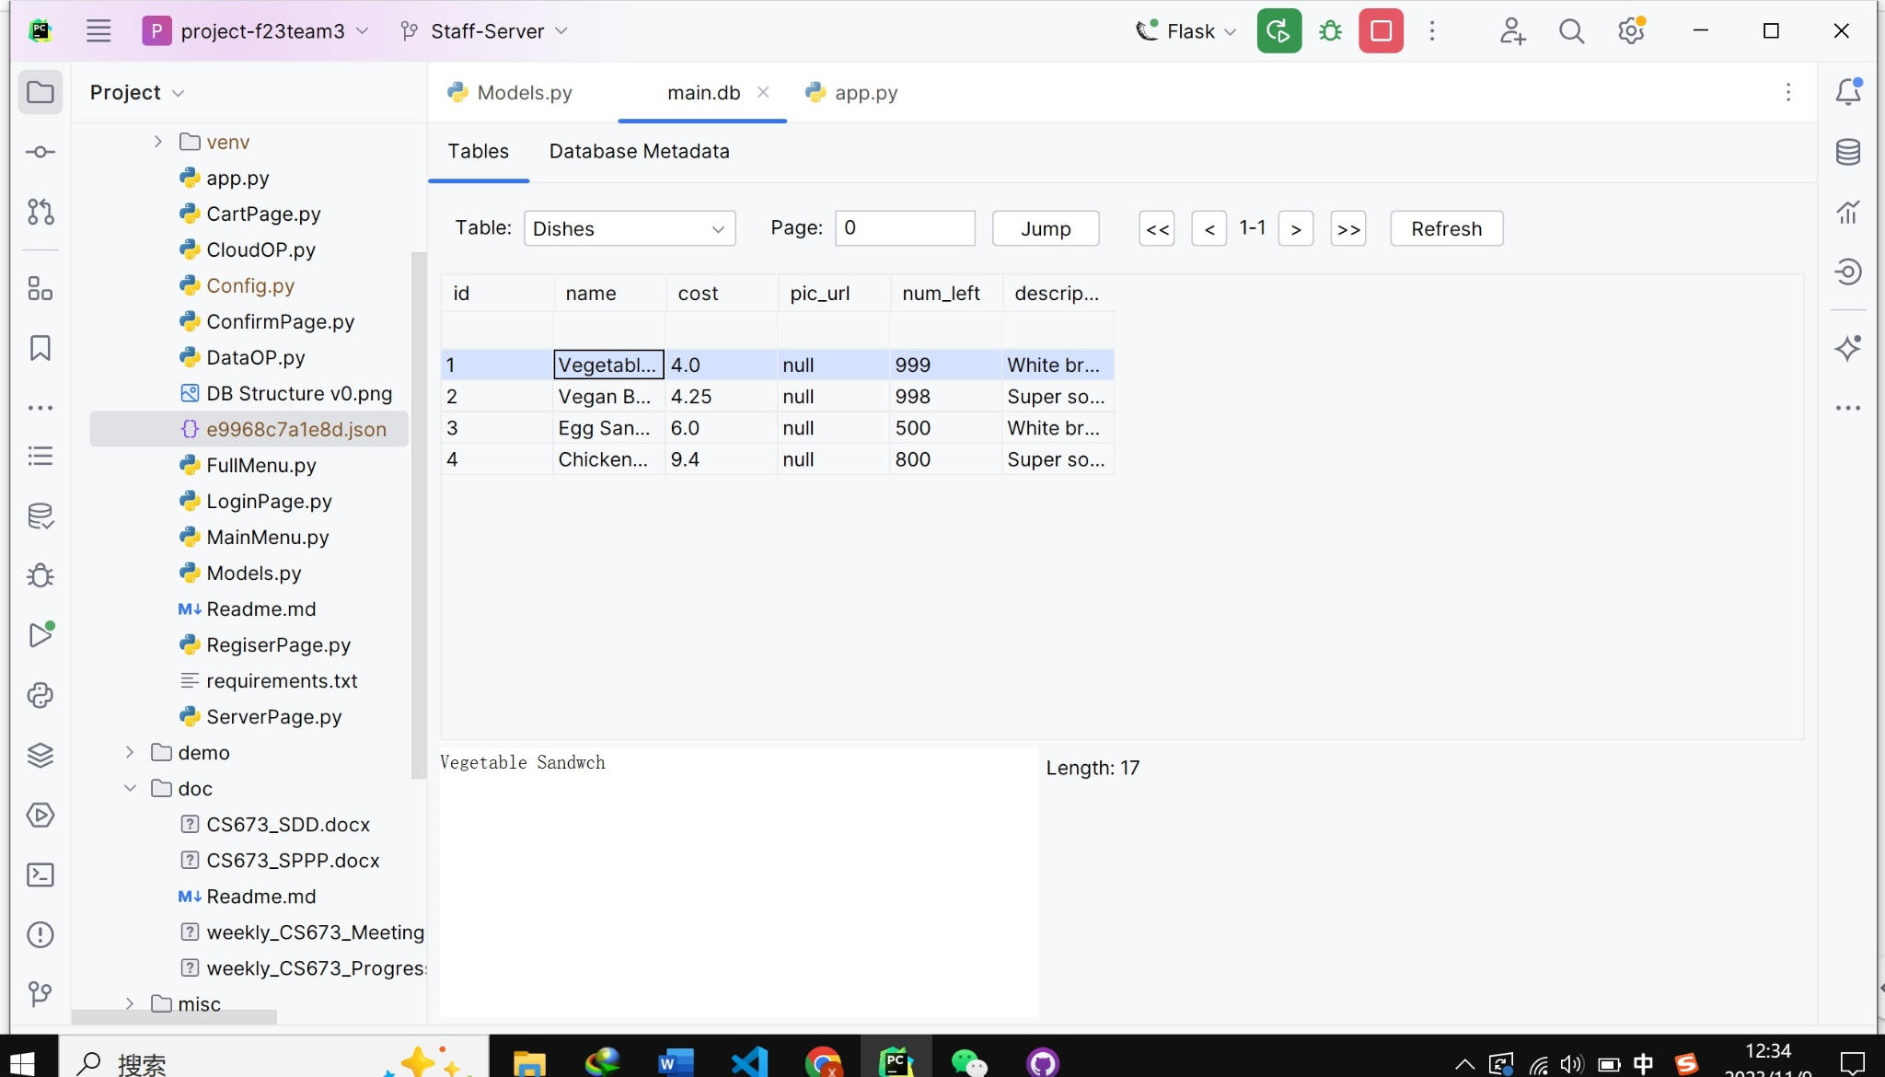

Slide 11
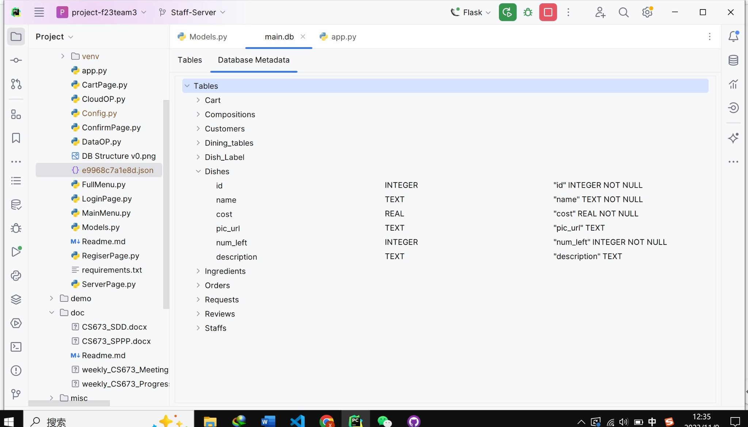

Slide 12
04 Software testing

Slide 13
Test Introduction
Embracing Test-Driven Development(TDD)
Defining TDD: A development approach where tests are written before code.
The Core Process: Write a failing test (Red), Write code to pass the test (Green), Refactor the code (Refactor).
TDD’s Role: Not just a testing strategy, but a holistic software development philosophy.

Slide 14
Applying TDD in Flask Applications
Implementing TDD in Flask
Our Scenario: Generating QR codes for restaurant tables.
Writing Tests First: Ensuring each function behaves as expected - from serving a status code 200 to displaying the correct QR code.
Development Cycle: Begin with a failing test for a new feature, write the code to pass, and refine the codebase.

Slide 15
Benefits of Test-Driven Development
Implementing TDD in Flask
The Value of TDD
Quality Assurance: Reduces bugs and improves code functionality.
Sustainable Design: Promotes a scalable and maintainable code architecture.
Confidence in Evolution: Future-proofing features, ensuring new code integrates seamlessly without breaking existing features.

Slide 16
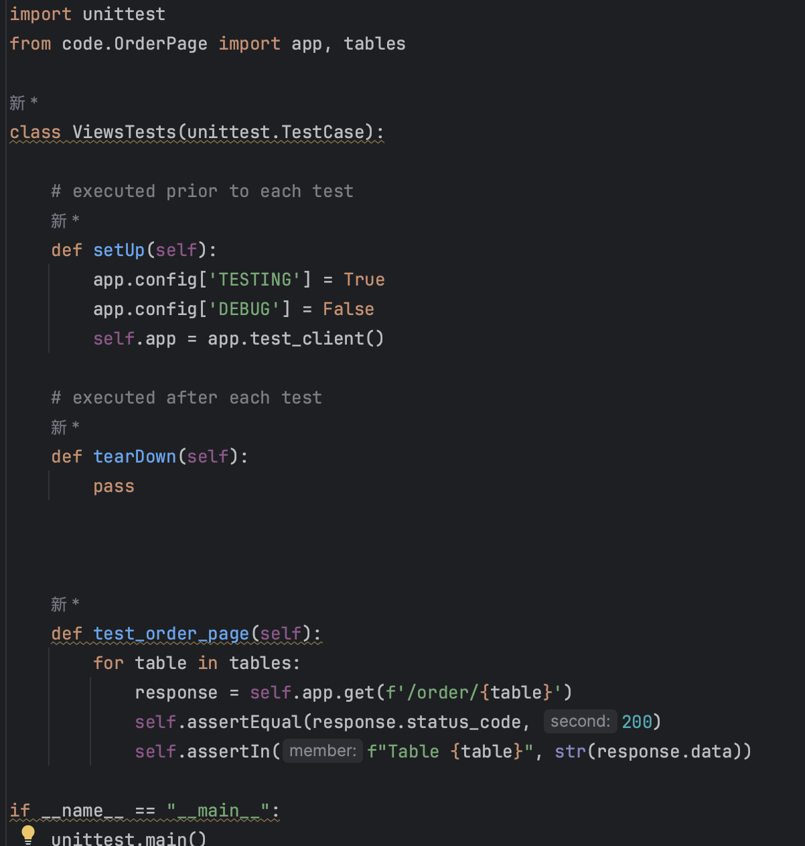
Test Example:Order Page

Slide 17
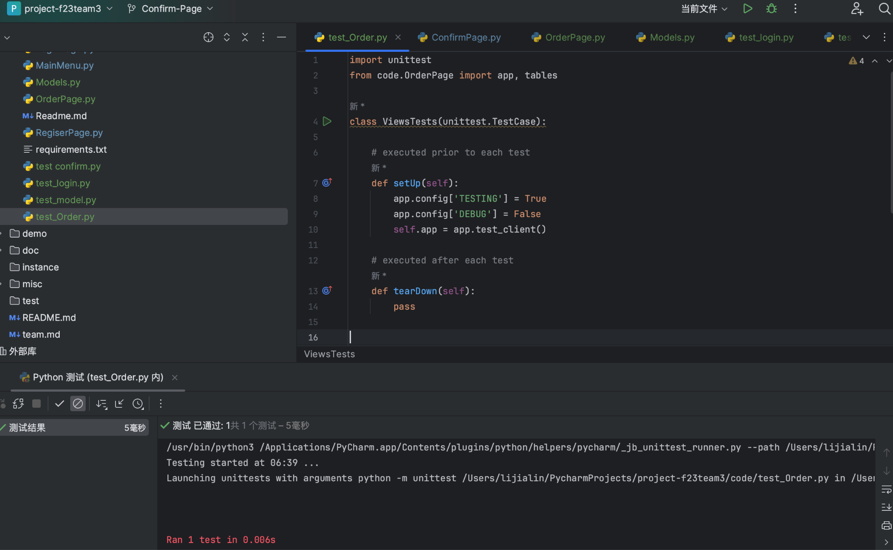
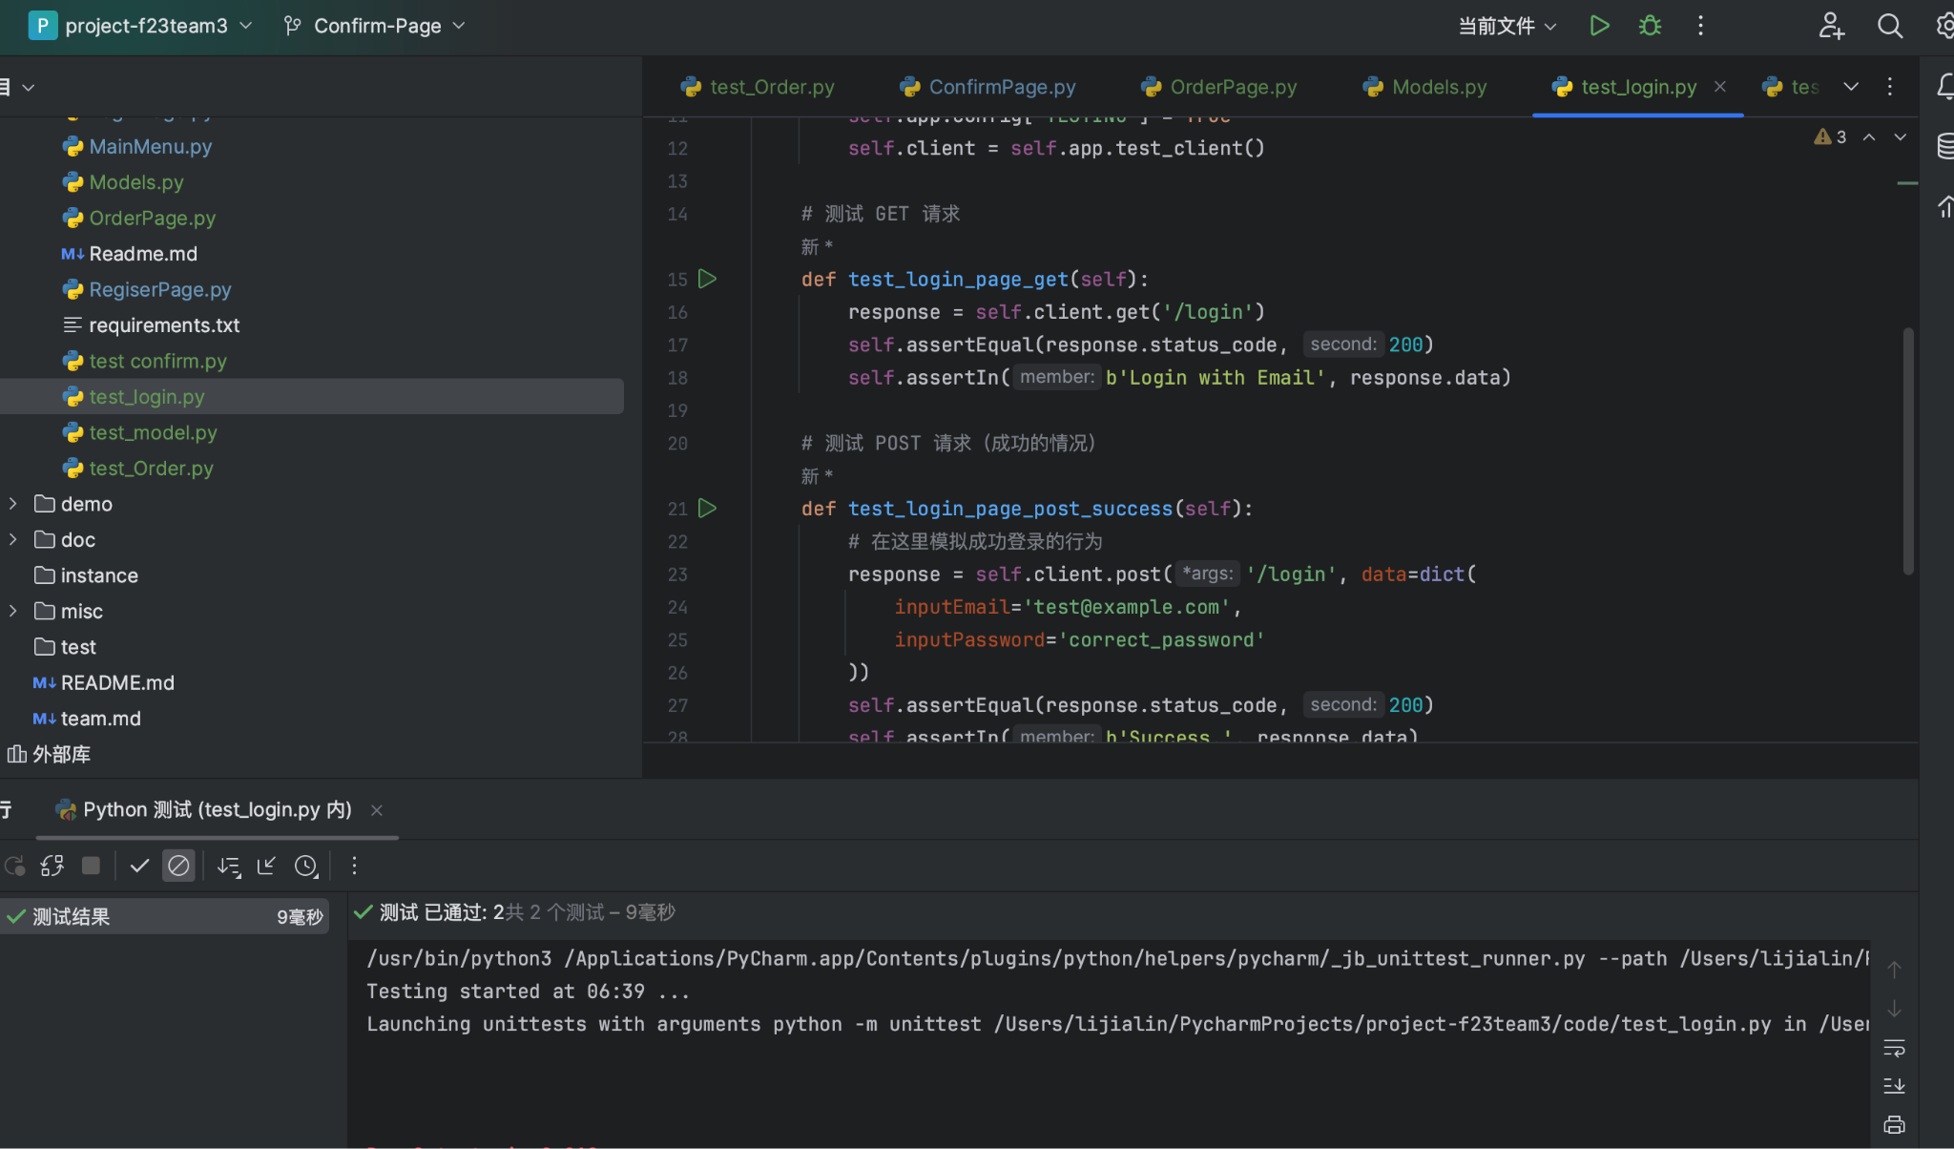
Test Result:Order Page and Login Page

Slide 18
05 What’s next for our Iteration 3
Fix the bugs
Add the Kitchen page
Complete the UI design
Refine and complete the customer and server module
Customer- comment page
Server- Alert page
Server- order management page
Integration testing and system testing

Slide 19
Thank you!
Jialin Li, QA Leader
Tony Xiang, Configuration Leader
Zhuoru Song, Requirement Leader
Xiankun Niu, Design and Implementation Leader

